Slide 1
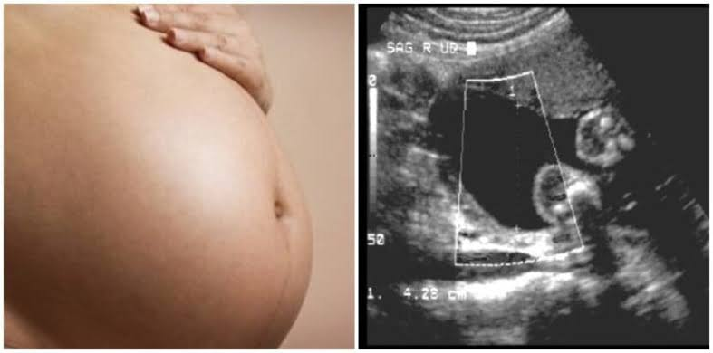
POLYHYDROMNIOS

Slide 2
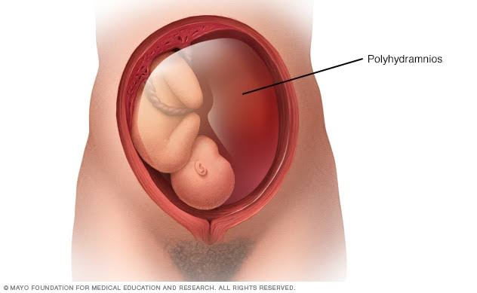
POLYHYDROMNIOS
DEFINITION: Anatomically, polyhydramnios is defined as a state where liquor amnii exceeds 2,000 mL.
Clinical definition : The excessive accumulation of liquor amnii causing discomfort to the patient when amniotic fluid index (AFI) is more than 24 cm (more than 95th centile for gestational age) and a deepest vertical pocket (DVP) is more than 8 cm.
Incidence: 1-2%

Slide 3
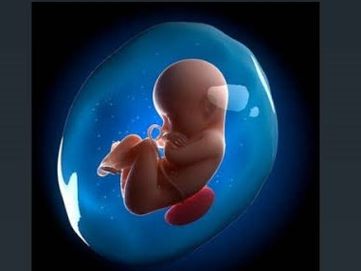
POLYHYDROMNIOS
It may be the result of deficient absorption as well as excessive production of liquor amnii, which may be temporary or permanent.
The composition of the liquor amnii, however, remains normal.
ETIOLOGY:
Idiopathic (50–60% )
Fetal anomalies
Placenta
Multiple pregnancy
Maternal conditions

Slide 4
ETIOLOGY
FETAL ANOMALIES: Congenital fetal malformations (structural and chromosomal) are associated with polyhydramnios in about 20% cases.
The causes of excessive production of liquor amnii may be due to:
(a) transudation from the exposed meninges,
(b) absence of fetal swallowing reflex
(c) possible suppression of fetal antidiuretic hormone leading to excessive urination.

Slide 5
2. FETAL ANOMALIES:
Open spina bifida : increased transudation from the meninges. 
Esophageal or duodenal atresia : preventing swallowing of the liquor.
 Facial clefts and neck masses : interfering normal swallowing. 
Hydrops fetalis :due to Rhesus isoimmunization, nonimmune hydrops, cardiothoracic anomalies, fetal cirrhosis and fetal infections with TORCH and parvovirus B19 infection
Aneuploidy and genetic syndromes

Slide 6
POLYHYDROMNIOS

Slide 7
ETIOLOGY
3. PLACENTA:
Chorioangioma of the placenta: Tumor growing from a single villus consisting of hyperplasia of blood vessels and connective tissue results in increased transudation
4. MULTIPLE PREGNANCY:
Hydramnios is more common in monozygotic twins, usually affecting the second sac.
In TTTS the recipient twin develops polydramnios.

Slide 8
ETIOLOGY
5. MATERNAL: (i) Diabetes (30%) —It is more common in hydramnios.
Rised maternal blood sugar
raised fetal blood sugar
fetal diuresis
hydramnios.
(ii) Cardiac or renal disease: may lead to edema of the placenta leading to increase in transudation.

Slide 9
POLYHYDROMNIOS
CLINICAL TYPES: Depending on the rapidity of onset, hydramnios may be:
(a) Chronic (most common) : onset is insidious taking few weeks.
(b) Acute (extremely rare) : onset is sudden, within few days or may appear acutely on pre-existing chronic variety. The chronic variety is 10 times more common than the acute one.

Slide 10
Polyhydramnios may be : (a) Mild : DVP > 8–11 cm
(b) Moderate : DVP: 12–15 cm
(c) Severe : DVP ≥ 16 cm

Slide 11
CHRONIC POLYHYDROMNIOS
SYMPTOMS: mainly from mechanical causes.
Respiratory : shortness of breath
Palpitations
Edema of the legs
Varicosities in the legs or vulva
Hemorrhoids.
SIGNS: The patient may be in a dyspneic state in the lying down position.
Evidence of preeclampsia (edema, hypertension and proteinuria) may be present.

Slide 12
CHRONIC POLYHYDROMNIOS
ABDOMINAL EXAMINATION:
Inspection: Abdomen is markedly enlarged
looks globular with fullness at the flanks
skin is tense, shiny with large striae
Palpation:
Height of the uterus is more than the period of amenorrhea.
Girth of the abdomen is more than normal (round the umbilicus)
Fluid thrill can be elicited in all directions over the uterus.
Fetal parts, presentation , position cannot be well-defined
External ballottement can be elicited more easily .

Slide 13
CHRONIC POLYHYDROMNIOS
Auscultation: Fetal heart sound is not heard distinctly, although its presence can be picked up by Doppler ultrasound
Internal Examination:
The cervix is pulled up may be partially taken up
May be dilated, to admit a fingertip through which tense bulged membranes can be felt.

Slide 14
INVESTIGATIONS
ABO and Rh grouping : Rhesus isoimmunization may cause hydrops fetalis and fetal ascites.
2. Random blood sugar and if necessary glucose tolerance test
3. Amniotic fluid: Estimation of alpha fetoprotein which is markedly elevated in the presence of a fetus with an open neural tube defect

Slide 15
INVESTIGATIONS
4. Sonography : to detect abnormally large echo-free space between the fetus and the uterine wall
(largest vertical pocket >8 cm). Amniotic fluid index (AFI) > 25 cm
To exclude multiple fetuses
To note the lie and presentation of the fetus
To diagnose any fetal congenital malformation. (Especially the central nervous system, gastrointestinal system and musculoskeletal system)

Slide 16
CHRONIC POLYHYDROMNIOS
MANAGEMENT:
(1) Early detection and control of diabetes.
(2) Rhesus isoimmunization is now preventable.
(3) Genetic counseling in early months and detection of fetal congenital abnormalities with ultrasound and their termination
Treatment of polyhydramnios is usually according to the underlying cause.

Slide 17
MILD POLYHYDRAMNIOS (DVP: 8–11 cm):
It is commonly found in midtrimester
usually requires no treatment
The excess liquor is expected to be diminished as pregnancy advances (transient)

Slide 18
SEVERE POLYHYDRAMNIOS (DVP: ≥16 cm):
Principles:
(1) To relieve the symptoms
(2) To find out the cause
(3) To avoid and to deal with the complication.

Slide 19
CHRONIC POLYHYDROMNIOS
Supportive therapy:
Bed rest
Treatment of the associated conditions like preeclampsia or diabetes on the usual line.
The use of diuretic is of little value.
Sulindac (COX-2 inhibitor), 200 mg every 12 hours, (under supervision) has been found to be most effective in unexplained cases.
It has been found to decrease amniotic fluid as it reduces fetal urine output.

Slide 20
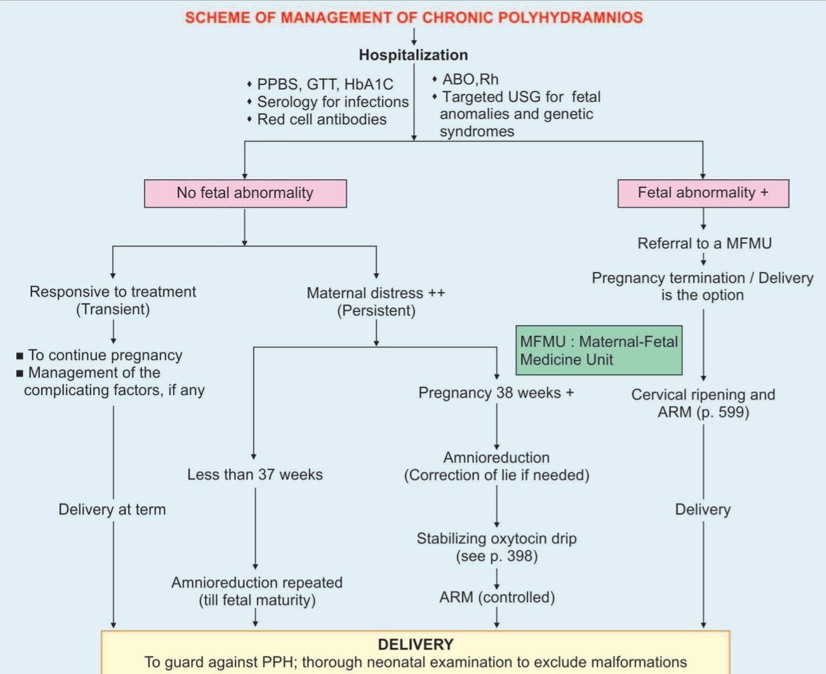

Slide 21
AMNIOCENTESIS
Amniocentesis (amnio reduction):
Slow decompression is done at the rate of about 500 ml/hr and the amount of fluid to be removed should be sufficient enough to relieve the mechanical distress.
Normally amniodrainage is stopped when the AFI is less than 25 cm.
Because of slow decompression, chance of accidental hemorrhage is less but liquor amnii may again accumulate, for which the procedure may have to be repeated.
Amniotic fluid can be tested for fetal lung maturity.

Slide 22
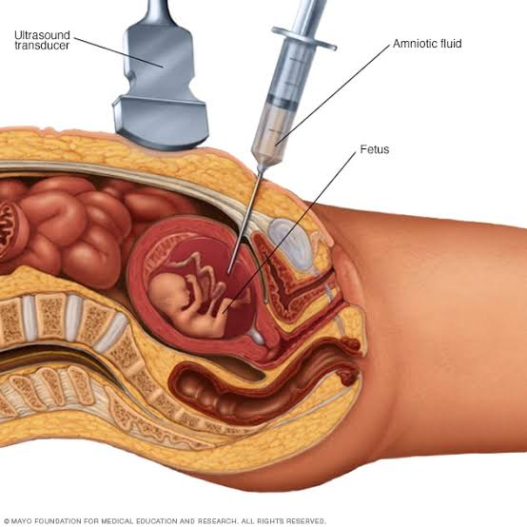
AMNIOCENTESIS

Slide 23
COMPLICATIONS
MATERNAL | FETAL
During pregnancy : Preeclampsia (25%) Malpresentation and persistence of floating head Premature rupture of the membranes Preterm labor either spontaneous or induced Accidental hemorrhage 2. During labor: Early rupture of the membranes Cord prolapse Uterine inertia Increased operative delivery due to malpresentation Retained placenta, postpartum hemorrhage (uterine atony) , shock. 3. Puerperium: Subinvolution Increased puerperal morbidity due to infection resulting from increased operative interference and blood loss | prematurity congenital abnormality (40%). Hydrops fetalis Effects of increased operative delivery and accidental hemorrhage

Slide 24
ACUTE POLYHYDROMNIOS
Acute hydramnios is extremely rare.
The onset is acute and the fluid accumulates within a few days.
It usually occurs before 20 weeks of pregnancy.
It is usually associated with monozygotic twins with TTTS or chorioangioma of the placenta.

Slide 25
ACUTE POLYHYDROMNIOS
SYMPTOMS: Abdominal pain
Nausea and vomiting.
SIGNS:
(i) The patient looks ill
(ii) Absence of features of shock
(iii) Edema of the legs or presence of other associated features of preeclampsia
(iv) Abdomen is hugely enlarged more than the period of amenorrhea; the wall is tense with shiny skin
(v) Fluid thrill is present
(vi) Fetal parts cannot be felt nor is the fetal heart sound audible

Slide 26
ACUTE POLYHYDROMNIOS
(vii) Internal examination reveals: taking up of the cervix or even dilatation of the os through which the bulged membranes are felt
(viii) Sonography shows multiple fetuses or at times fetal abnormalities

Slide 27
ACUTE POLYHYDROMNIOS
TREATMENT:
Most often, spontaneous abortion occurs.
In case with severe TTTS, repetitive amnioreduction until the AFI is normal, may improve the perinatal outcome.
Laser ablation may cure the cause of TTTS whereas amnioreduction only treats the symptoms

Slide 28
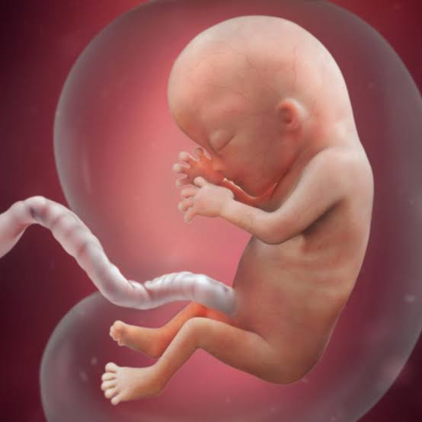
THANKYOU

